Slide 1

AI Coder: Vibe Coder to Agentic Engineer
The Missing Manual
Week 1
Day 4

Slide 2
3 Weeks to Expert Agentic Coder
Core skills
Products / Features
Projects
Week 3: Agentic Engineering as an expert
Multi-Agents
Sub-Agents
Hooks
Sandboxing
Large Codebase
Workflow
Swarms
Orchestrators
Project 4: Capstone
Week 2: Vibe Engineering as a professional
Claude Code
OpenCode
others
Commands
Checkpoints
Ralph Loops
MCP
Skills
Plugins
Workflows
Team
Debugging
Project 3: SaaS Platform
Week 1: Vibe Coding for fun and profit
Agentic Coding Landscape
Foundations
AGENTS.md
Context
Cursor
Copilot, Codex
Antigravity
Project 1: YOLO
Project 2: Commercial MVP

Slide 3
Recap
We looked at four IDEs
Cursor
Anysphere
A fork of VS Code
Github Copilot
Github / MSFT
Often VS Code extension
Codex
OpenAI
Can be VS Code extension
Antigravity
Google
A fork of VS Code
We used different LLMs as Coding Agents
Composer
Anysphere
Fast frontier
200K context
Claude Haiku 4.5
Anthropic
Fast frontier
200K context
GPT 5.2-Codex
OpenAI
Frontier
272K context
Gemini 3 Pro
Google
Frontier
1,000K context
Practical rules of thumb:
Favor intelligence over speed
Pick the most intelligent model your budget allows
With smaller models, allow for greater prompting and oversight
Avoid YOLO with fast frontier or open-source

Slide 4





For Success: Be The Boss
Invest in AGENTS.md
Concisely: spec, style, success
Start SIMPLE
Work incrementally; test constantly; validate success criteria
Don’t get lazy - challenge & demand evidence
Handle frustration with style

Slide 5



For Success: Be The Boss
For Junior Engineers:
Keep learning
Be skeptical
For Senior Engineers:
Keep building
Keep enjoying
For everyone:
Expect mixed results - recognize the downside; it’s a net positive

Slide 6
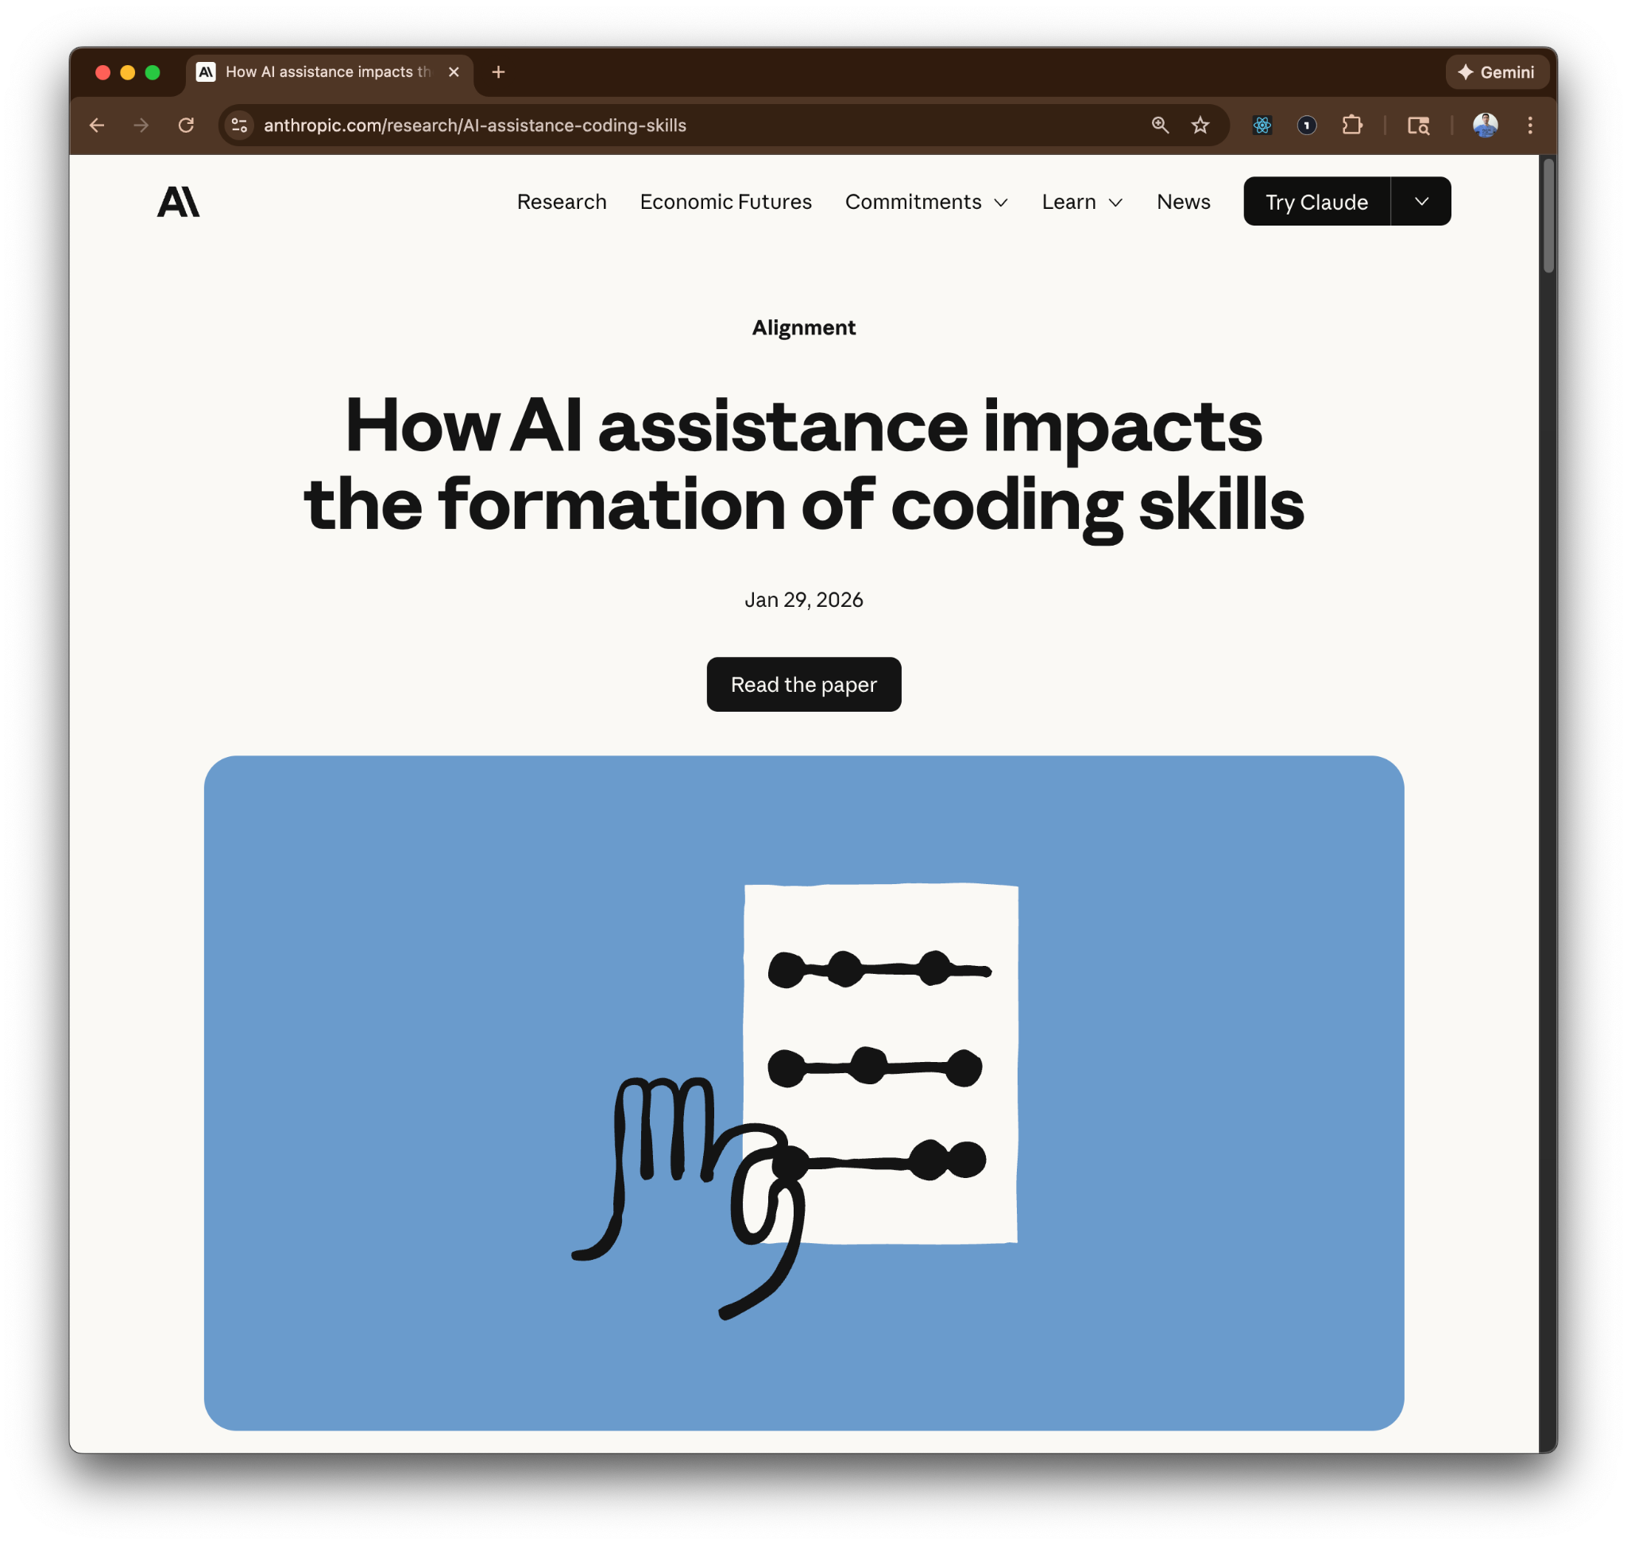
A candid appraisal

Slide 7
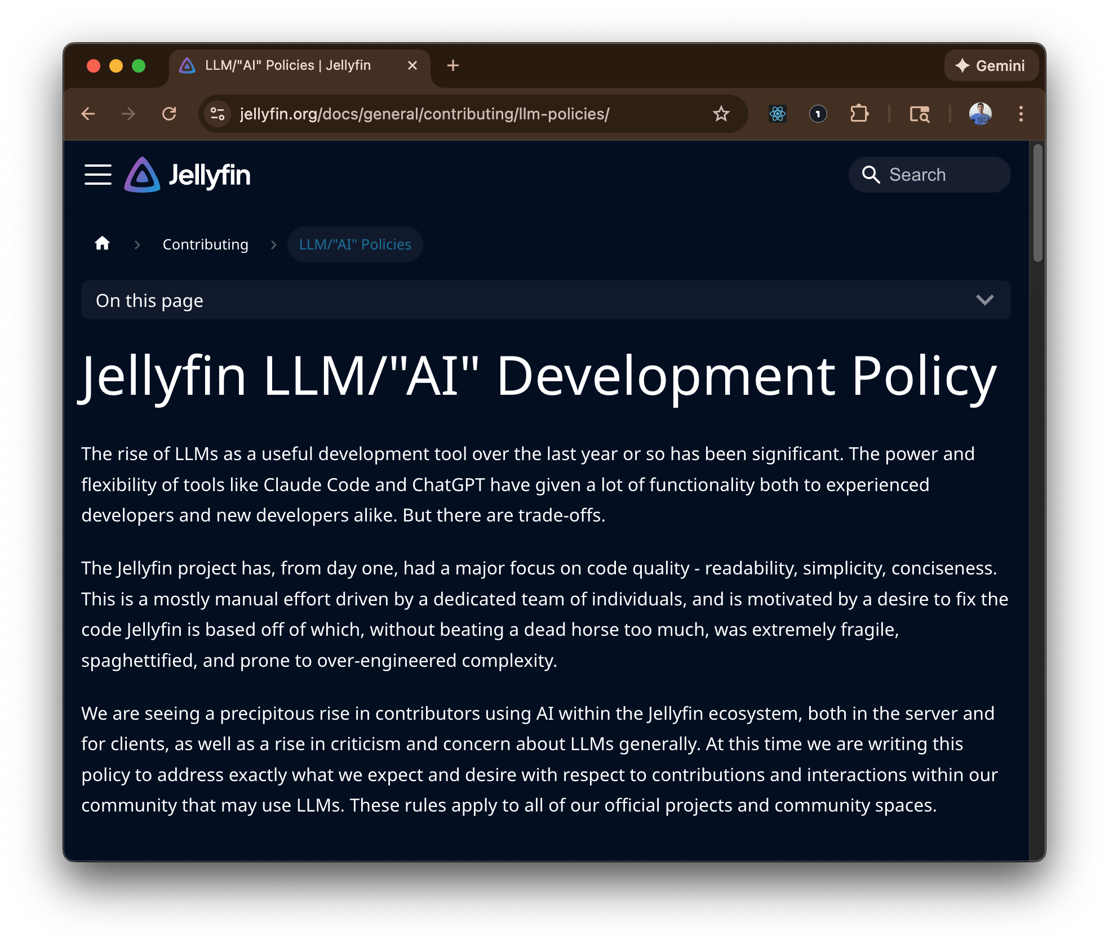
You own the code

Slide 8



Frame of mind
Everything is optional
Your results may vary
If problems: simplify

Slide 9
3 Weeks to Expert Agentic Coder
Core skills
Products / Features
Projects
Week 3: Agentic Engineering as an expert
Multi-Agents
Sub-Agents
Hooks
Sandboxing
Large Codebase
Workflow
Swarms
Orchestrators
Project 4: Capstone
Week 2: Vibe Engineering as a professional
Claude Code
OpenCode
others
Commands
Checkpoints
Ralph Loops
MCP
Skills
Plugins
Workflows
Team
Debugging
Project 3: SaaS Platform
Week 1: Vibe Coding for fun and profit
Agentic Coding Landscape
Foundations
AGENTS.md
Context
Cursor
Copilot, Codex
Antigravity
Project 1: YOLO
Project 2: Commercial MVP

Slide 10

AI Coder: Vibe Coder to Agentic Engineer
The Missing Manual
27%
Complete

